Slide 1





CARE
COMMISSION
INFORMATIONAL MEETING

Slide 2
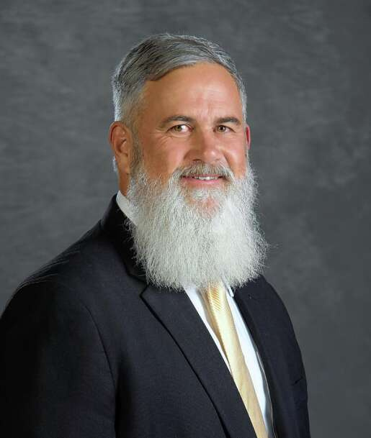
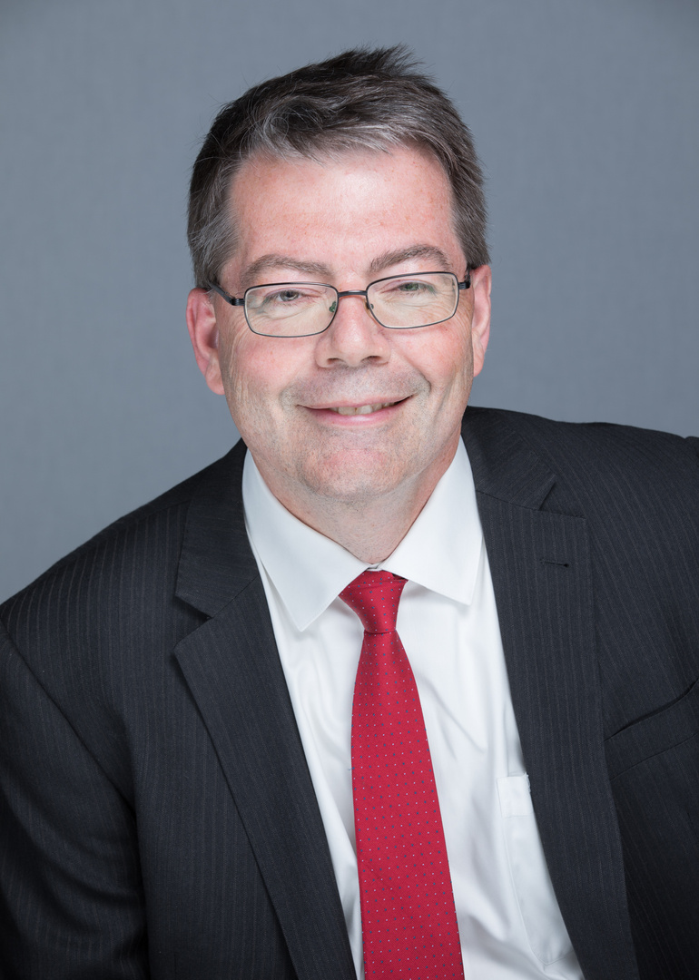
Introductions
Trustee Kevin Woodside
Mayor Tom Hood

Slide 3


Why start a Care Commission?
  Because…
  Non-profits and community organizations play a vital role in supporting residents' well-being.
  We can assist these groups to expand their reach, respond to urgent needs, and launch new initiatives.
  Investing in these organizations builds a stronger, more connected, and resilient Gurnee.
  Thanks to prudent budgeting, the Village can invest in non-profit organizations in the same way we have supported small businesses.

Slide 4


Priorities of the Commission
Recognize
  Identify Stakeholders:
    Gather input from residents, businesses, government agencies, non-profits, service providers, etc.
  Get Informed:
    Use data and insights from stakeholders to understand urgent challenges.

Slide 5


Priorities of the Commission
Reach
  Identify organizations that meet identified needs.
  Connect service providers with those seeking assistance.
  Partner with those essential organizations.

Slide 6


Priorities of the Commission
Reinforce
  Empower organizations through funding, resources, and volunteer engagement.
  Strengthen community resilience by ensuring vital services remain accessible and sustainable.

Slide 7


Commission Member Details
  Must be a Gurnee Resident or have a strong connection to Gurnee (Business/Organization)
  No experience required – just a desire to serve in this way
  We are looking for diverse:
    Backgrounds
    Perspectives
    Ages: High School and up
  Commission members will be appointed by the Mayor
  Two year appointment – can serve consecutive terms
  Please turn in a “Community Involvement & Volunteer” related cover letter and/or resume to mtrujillo@village.gurnee.il.us by Friday, April 18, 2025.

Slide 8


Meeting Details
  Meetings are initially expected to be the second Tuesday of the Month at 7pm.
  Meeting schedule may adjust as the mission is refined and committees formed.
  Members will work with each other to facilitate programs and initiatives to support the non-profits in the community.

Slide 9

Lets Stay in Touch!
  Information will be available on the Village of Gurnee Care Commission webpage
  Add yourself to our email contact list that will share information regarding the Care Commission.

Slide 10


Next Steps
  Apply to be on the Care Commission
    Please turn in a “Community Involvement & Volunteer” related cover letter and/or resume to mtrujillo@village.gurnee.il.us by Friday, April 18, 2025.
  First Care Commission Meeting is expected to be Tuesday, June 10, 2025 at 7pm
  Send this opportunity to someone who might be interested!

Slide 11

Questions

Slide 12


