Slide 1


Arts Commission

Slide 2
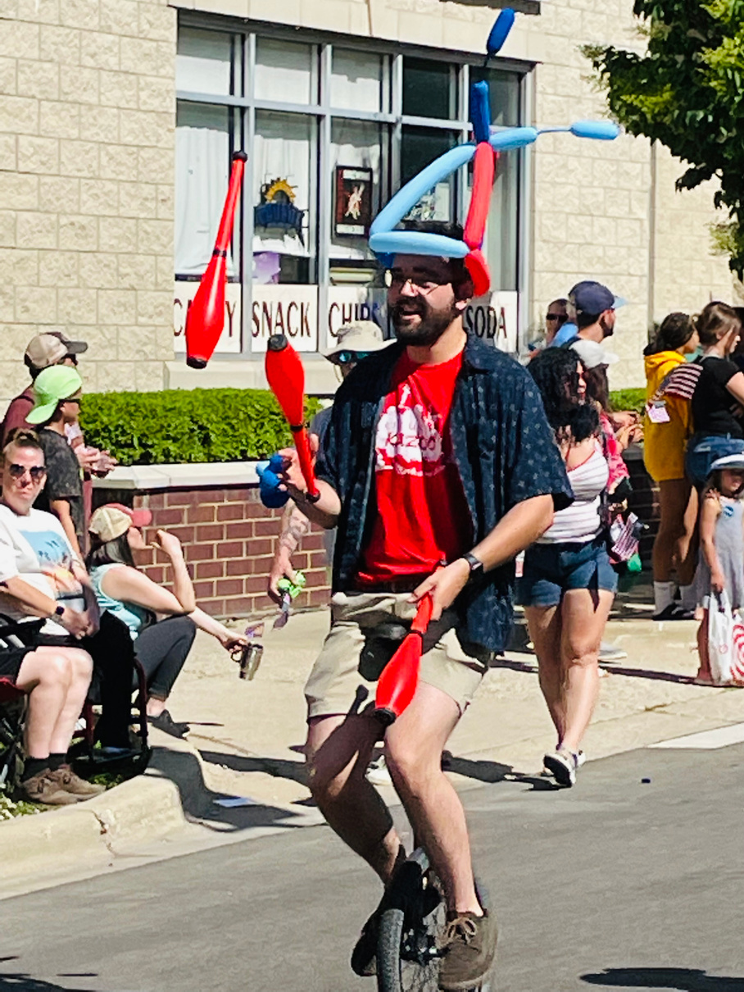
Introduction
  Matt Trujillo, Community Engagement Coordinator
    I work on community events and initiatives, oversee our Small Business Capital Grant Program, and assist with some Economic Development projects.
  I will be the Staff Liaison for the Arts Commission
  I do Circus Arts!
    Juggling, unicycles, balloon animals, and clowning.
    I went to school at Illinois State University and performed in the Gamma Phi Circus for 4 years.
    I teach youth circus at Circus Kazoo in Grayslake, IL.

Slide 3
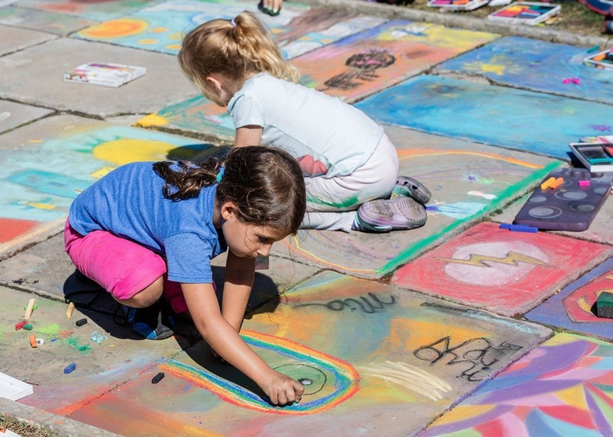
Why start an Arts Commission?
  Art is important!
    We have many artists in the Gurnee community.
    Dance, music, painting, sculpting, drawing, photography, theater, culinary, floral design, woodworking, and more!
  The Village wants to encourage and support a vibrant art scene in Gurnee
    This new Arts Commission will create that through arts programs/events and public art.

Slide 4

Commission Member Details
  10 Members on the Arts Commission
    Gurnee Residents & Businesses/Organizations who are interested in supporting the Arts Community.
    Will need to attend monthly meetings - It is important that the commission members attend the meetings, because this is an active working commission.
    Members will work with each other to facilitate arts programs and events.
    Members will plan and execute public art projects.
  Members will be appointed by the Mayor
    Please turn in a “Community Involvement & Arts” related cover letter and resume or portfolio to mtrujillo@village.gurnee.il.us by Friday, April 11, 2025.
    The Commission is looking for a variety of different artistic backgrounds.
    Highschool aged students are encouraged to apply.
    An Arts Commission Chair person will be appointed.
    Arts Commission Member Commitments will be 2 years long.
    Members can serve consecutive terms.

Slide 5
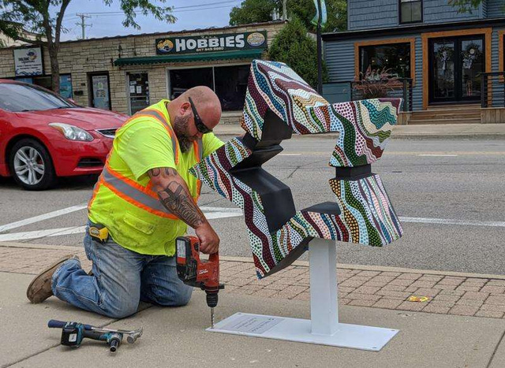
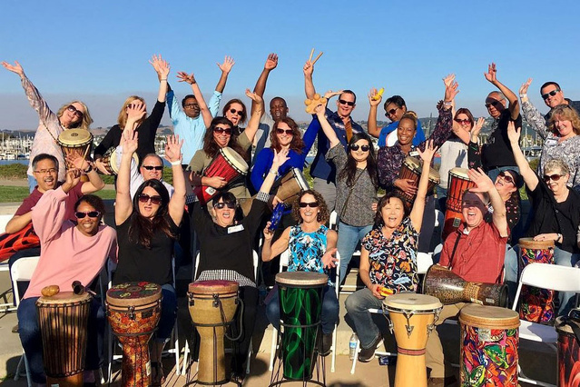
Commission Member Details
  Open Meetings Act of Illinois
    The Commission will be required to follow the Open Meetings Act of Illinois.
      This makes all monthly meetings public.
      Quorum (6 members) needs to be met for all meetings of the full Commission.
      Sub-committees of 3 can be formed to work on projects outside of public meetings. Recommendations will be discussed at the monthly meetings.

Slide 6
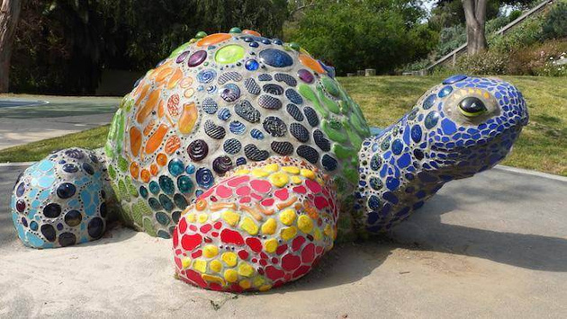
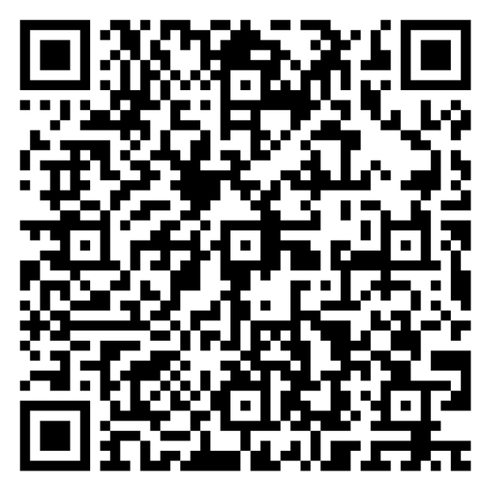
Commission Member Details
  Conflict of Interest
    To maintain the integrity of the commission, conflict of interest policies listed in the Village of Gurnee’s Code of Ordinances will be adhered to. Sec. 2-287. – Conflict of Interest (Ord. No. 2005-97, § I, 11-7-2005)
    No artist who serves on the Gurnee Art Commission should profit as a result of their participation on the committee. This would prohibit any paid commissioned art projects undertaken by commissioners or their immediate family members.

Slide 7

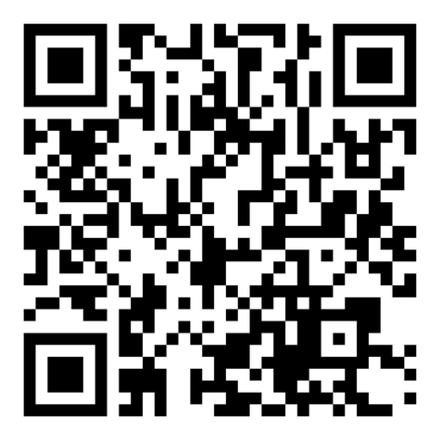
Lets Stay in Touch!
  Whether you are interested in being a Commission Member or just interested in opportunities to get involved in the Arts Commission, please share your contact information so we can add you to our email list.
Add your email here:
https://mailchi.mp/village/gurnee-arts-commission
*This will serve as our Arts Commission Info contact list*

Slide 8
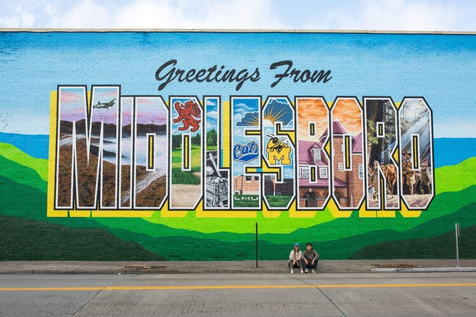
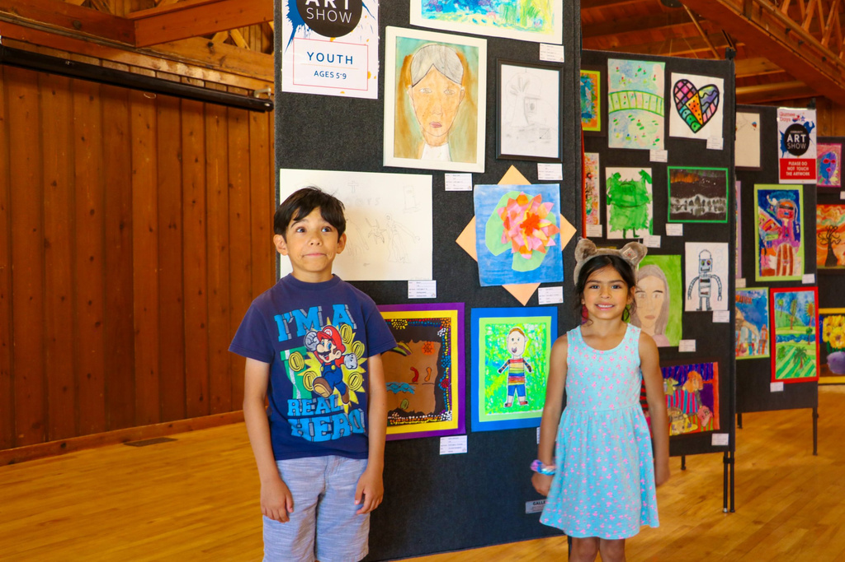
Arts Commission
  Projects/Programs/Initiatives
    This will be up to the Arts Commission with approval by Administration and/or the Village Board.
    We encourage the Arts Commission to bring their unique artistic passions to the group so we have a diverse range of art programs to offer to the community.
  Nothing will be decided tonight or before the Arts Commission is formed, but we encourage you to start brainstorming!

Slide 9
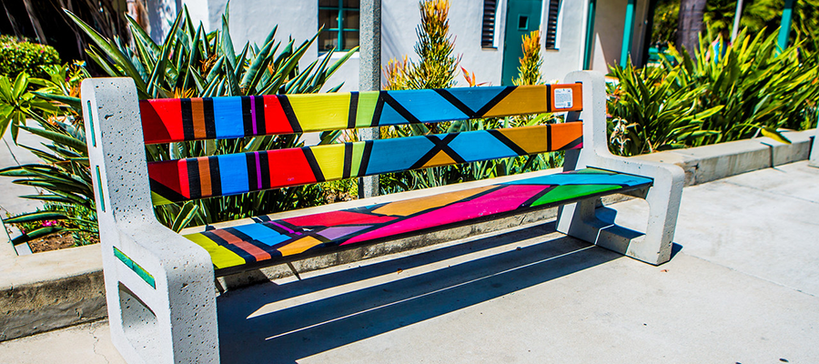
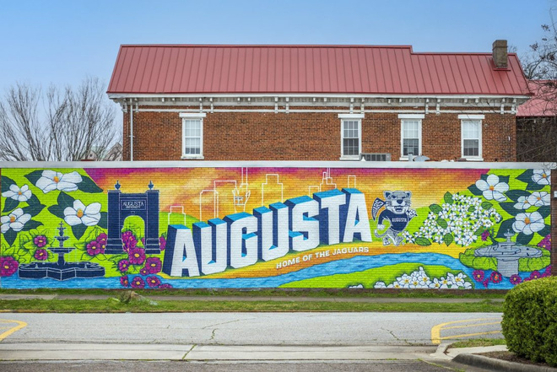
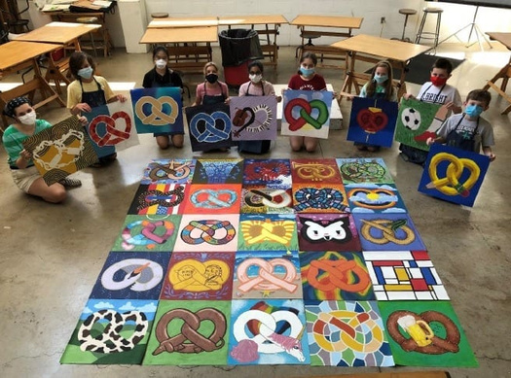
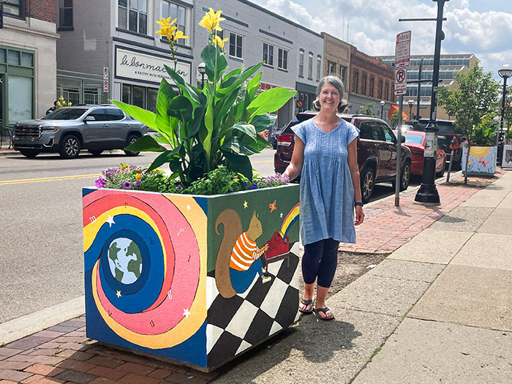
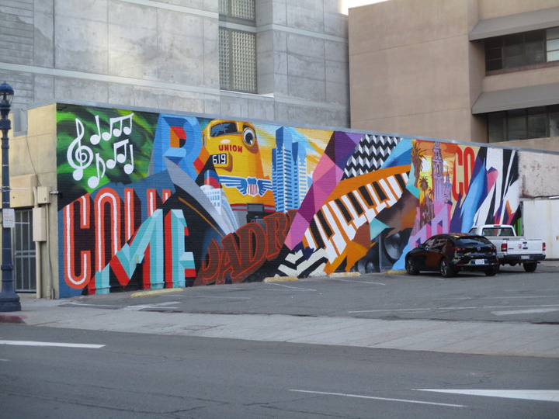
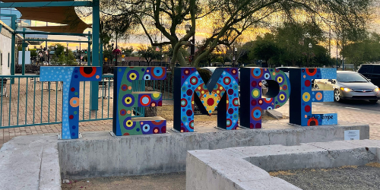
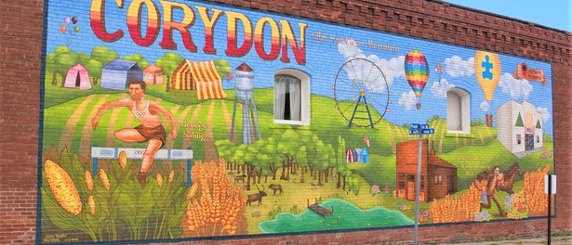
Art Examples

Slide 10

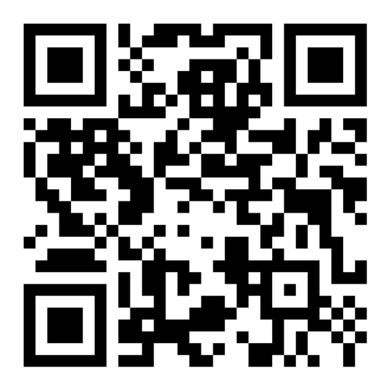
What questions do you have?
  If you think of questions later, or ideas that you would like to share please add them to the list:
https://www.surveymonkey.com/r/3CQVB93

Slide 11
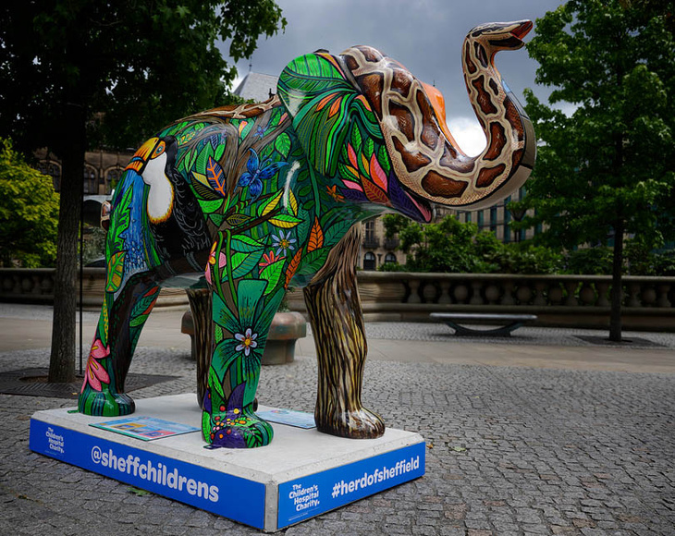
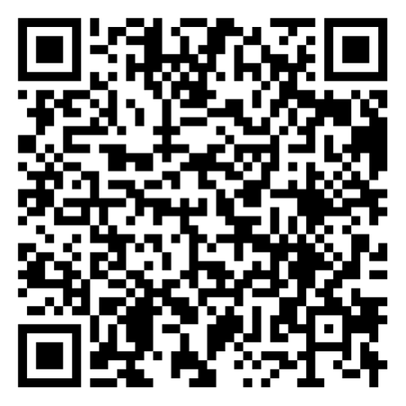
Gurnee Arts Commission Webpage
  Information will be available on the Gurnee Arts Commission webpage
https://www.gurnee.il.us/government/boards--commissions-and-committees/arts-commission

Slide 12


Next Steps
Contact List
  2nd Informational Meeting
    Monday, March 10, 2025 at 6pm
    Questions will be answered.
  Add your email to the contact list!
  Let us know any questions or ideas you have!
Questions

Slide 13


Next Steps
  If you are a resident or business/organization interested in joining the Arts Commission:
      Please turn in a “Community Involvement & Arts” related cover letter and resume or portfolio to mtrujillo@village.gurnee.il.us by Friday, April 11, 2025.
  Meetings are expected to be the second Monday of the Month at 6pm. (Holidays may move meetings, but we are looking at Monday evenings)

Slide 14


