Slide 1




Gurnee Neighborhood Watch
Northeast Gurnee
Officer Tom Woodruff
Gurnee Police Department
100 N. O’Plaine Rd.
Gurnee, IL 60031
Phone: 847-599-7000 24 hour
Voicemail: 847-599-7152
Email: tomw@police.gurnee.il.us
Det. Matt Bendler
Gurnee Police Department
100 N. O’Plaine Rd.
Gurnee, IL 60031
Phone: 847-599-7000 24 hour
Voicemail: 847-599-7149
Email: mattrb@police.gurnee.il.us
Officer Ben Bozer
Gurnee Police Department
100 N. O’Plaine Rd.
Gurnee, IL 60031
Phone: 847-599-7000 24 hour
Voicemail: 847-599-7154
Email: bbozer@police.gurnee.il.us
“Honor-Integrity-Service”

Slide 2
Gurnee Neighborhood Watch
Northeast Gurnee
Mission Statement:
The primary purpose of our neighborhood watch program is to establish and maintain partnerships with residents throughout the community. The partnership will be rooted in two-way communication, periodic meetings, and information sharing.
The prevention of crime and furthering of community policing strategies are the primary goals of the program.
“Honor-Integrity-Service”

Slide 3
Gurnee Neighborhood Watch
Northeast Gurnee
What Our Neighborhood Watch is Not
Not a supplemental patrol force
Not a vigilante group or mentality
There are no citizen patrols
Provides no shield for citizens to act on their own
“Honor-Integrity-Service”

Slide 4
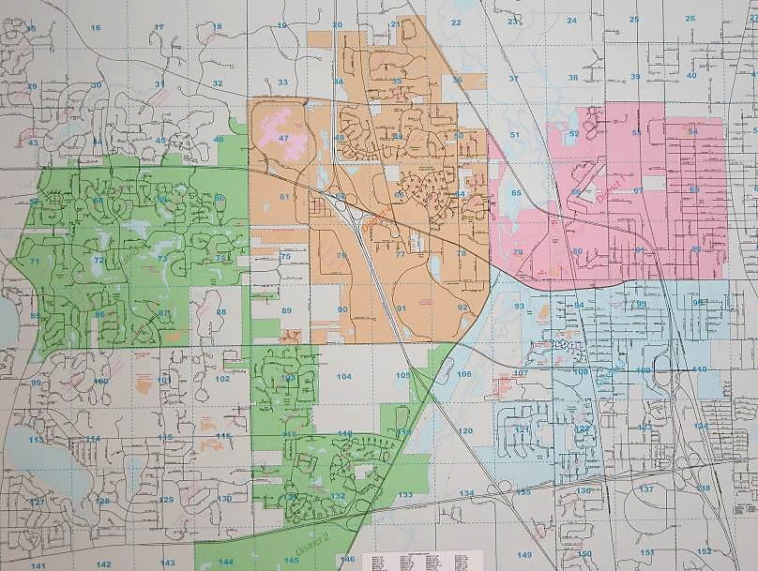
37 patrol beats converted to 17 separate groups
“Honor-Integrity-Service”

Slide 5
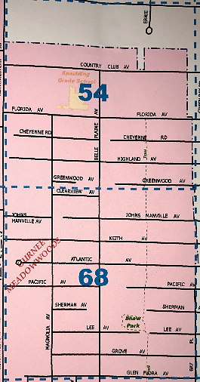
Gurnee Neighborhood Watch
Northeast Gurnee
“Honor-Integrity-Service”

Slide 6
“Honor-Integrity-Service”

Slide 7
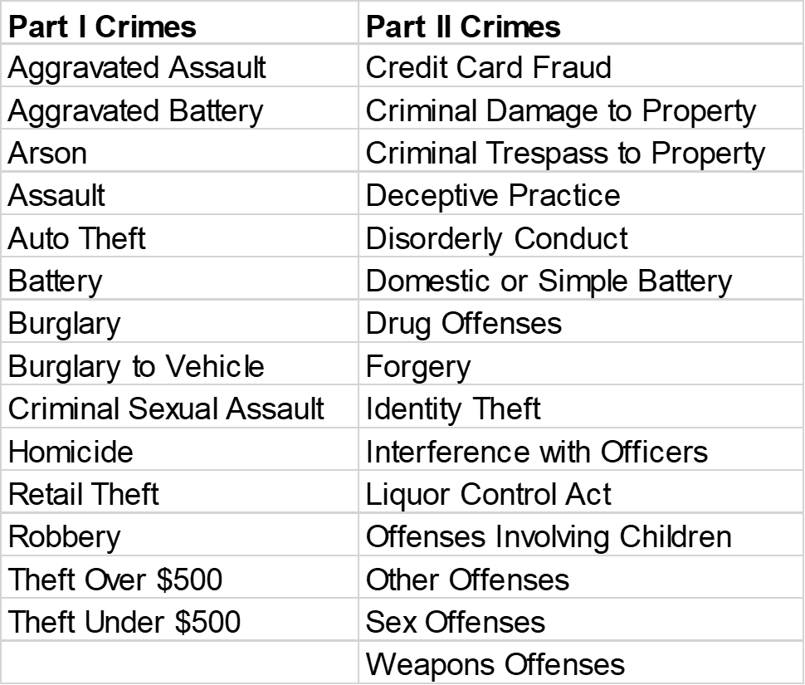
“Honor-Integrity-Service”

Slide 8
Gurnee Neighborhood Watch
Northeast Gurnee
Beats 54 and 68 crimes; 2018 page 1
“Honor-Integrity-Service”

Slide 9
Gurnee Neighborhood Watch
Northeast Gurnee
Beats 54 and 68 crimes; 2018 page 2
“Honor-Integrity-Service”

Slide 10
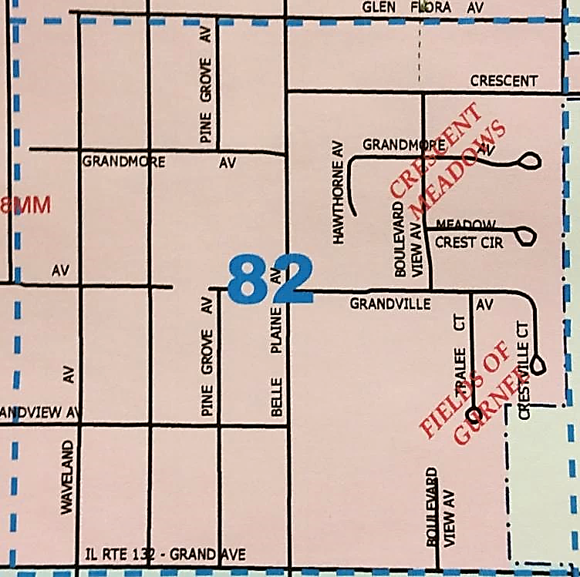
Gurnee Neighborhood Watch
Northeast Gurnee
“Honor-Integrity-Service”

Slide 11
“Honor-Integrity-Service”

Slide 12
“Honor-Integrity-Service”

Slide 13
Gurnee Neighborhood Watch
Northeast Gurnee
Beat 82 crimes; 2018, page 1 (alphabetical by offense)
“Honor-Integrity-Service”

Slide 14
Gurnee Neighborhood Watch
Northeast Gurnee
Beat 82 crimes; 2018, page 2 (alphabetical by offense)
“Honor-Integrity-Service”

Slide 15
Gurnee Neighborhood Watch
Northeast Gurnee
Beat 82 crimes; 2018, page 3 (alphabetical by offense)
“Honor-Integrity-Service”

Slide 16
Gurnee Neighborhood Watch
Northeast Gurnee
Beat 82 crimes; 2018, page 4 (alphabetical by offense)
“Honor-Integrity-Service”

Slide 17
Gurnee Neighborhood Watch
Northeast Gurnee
Beat 82 crimes; 2018, page 5 (alphabetical by offense)
“Honor-Integrity-Service”

Slide 18
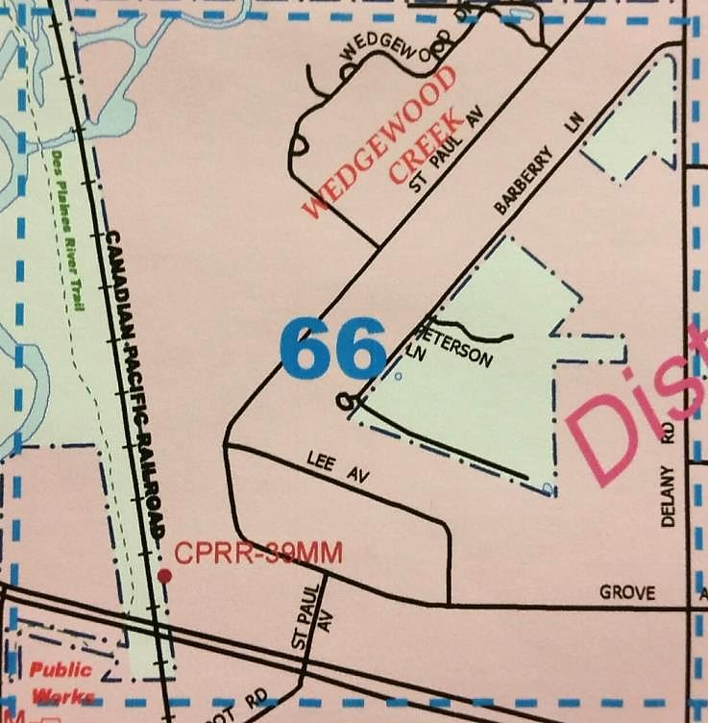
Gurnee Neighborhood Watch
Deer Creek
“Honor-Integrity-Service”

Slide 19
“Honor-Integrity-Service”

Slide 20
“Honor-Integrity-Service”

Slide 21
Gurnee Neighborhood Watch
Northeast Gurnee
Deer Creek crimes; 2018
“Honor-Integrity-Service”

Slide 22
Gurnee Neighborhood Watch
Questions and/or discussion
“Honor-Integrity-Service”

Slide 23
Gurnee Neighborhood Watch
Legislative Changes Effective 01/01/19
Public Safety
Orders of Protection
Transportation
Criminal Law
“Honor-Integrity-Service”

Slide 24
Gurnee Neighborhood Watch
Legislative Changes Effective 01/01/19
“Honor-Integrity-Service”

Slide 25
Gurnee Neighborhood Watch
Legislative Changes Effective 01/01/19
Public Safety
“Honor-Integrity-Service”

Slide 26
Gurnee Neighborhood Watch
Legislative Changes Effective 01/01/19
Lethal Order of Protection: Public Act 100-0607
Provides that a petitioner may request an emergency lethal violence order of protection by filing an affidavit or verified pleading alleging that the respondent poses an immediate and present danger of causing personal injury to himself, herself, or another by having in his or her custody or control, owning, purchasing, possessing, or receiving a firearm.
Provides that the petitioner may be a family member of the respondent or a law enforcement officer, who files a petition alleging that the respondent poses a danger of causing personal injury to himself, herself, or another by having in his or her custody or control, owning, purchasing, possessing, or receiving a firearm.
Establishes factors that the court must consider before issuing a firearms restraining order.
Provides for the issuance of temporary orders (14 days) and 6-month orders.
“Honor-Integrity-Service”

Slide 27
Gurnee Neighborhood Watch
Legislative Changes Effective 01/01/19
FOID Renewal and Suspension: Public Act 100-0906
Provides that renewal applications shall be approved or denied within 60 business days, provided the applicant submitted his or her renewal application prior to the expiration of his or her Firearm Owner's Identification Card.
Defines "patient" …as a person who is admitted as an inpatient or resident of a public or private mental health facility for mental health treatment under the Mental Health and Developmental Disabilities Code as an informal admission, a voluntary admission, a minor admission, an emergency admission, or an involuntary admission, unless the treatment was solely for an alcohol abuse disorder; or a person who voluntarily or involuntarily receives mental health treatment as an out-patient … and who poses a clear and present danger to himself, herself, or to others…
“Honor-Integrity-Service”

Slide 28
Gurnee Neighborhood Watch
Legislative Changes Effective 01/01/19
Unlawful Sale or Delivery of Firearms: Public Act 100-0606
Provides that a person commits the offense of unlawful sale or delivery of firearms when he or she knowingly delivers any firearm, incidental to a sale, without withholding delivery of the firearm for at least 72 hours after application for its purchase has been made (current law permits delivery of a rifle, shotgun or other long gun, or a stun gun or taser after 24 hours after application for its purchase has been made).
Provides that a violation is a Class 4 felony.
Eliminates the exemption from the waiting period requirements for the sale of a firearm to a nonresident of Illinois while at a firearm showing or display recognized by the Illinois Department of State Police.
“Honor-Integrity-Service”

Slide 29
Gurnee Neighborhood Watch
Legislative Changes Effective 01/01/19
School Safety Drill Act : Public Act 100-0996
Provides that, no later than 90 days after the first day of each school year, schools must conduct at least one law enforcement drill that addresses an active threat or an active shooter within a school building.
Requires all law enforcement drills to be conducted on days and times when students are normally present in the school building (rather than allowing the drill to be conducted on days and times when students are not present in the school building).
Provides that the appropriate local law enforcement agency shall observe the administration of the drill.
Allows administrators or school support personnel the discretion to exempt students from law enforcement drills.
“Honor-Integrity-Service”

Slide 30
Gurnee Neighborhood Watch
Legislative Changes Effective 01/01/19
Orders of Protection
“Honor-Integrity-Service”

Slide 31
Gurnee Neighborhood Watch
Legislative Changes Effective 01/01/19
Protection Orders: Public Act 100-0639
Amends the Illinois Domestic Violence Act of 1986 and the Protective Orders Article of the Code of Criminal Procedure of 1963.
To the list of protected persons, adds any of the following persons abused by a family or household member of a child:
a foster parent of that child if the child has been placed in the foster parent's home by the DCFS or by another state's public child welfare agency;
a legally appointed guardian or legally appointed custodian of that child;
an adoptive parent of that child; or
a prospective adoptive parent of that child if the child has been placed in the prospective adoptive parent's home pursuant to the Adoption Act or pursuant to another state's law.
“Honor-Integrity-Service”

Slide 32
Gurnee Neighborhood Watch
Legislative Changes Effective 01/01/19
Stalking – No Contact Order Act: Public Act 100-1000
Amends the Stalking No Contact Order Act.
Defines stalking behavior to include sending unwanted messages via social media.
Changes the definition of "course of conduct", "conduct", "petitioner", and "stalking".
Adds the following to the list of persons who may bring a petition under the Act:
an authorized agent of a workplace;
an authorized agent of a place of worship; and
an authorized agent of a school.
“Honor-Integrity-Service”

Slide 33
Gurnee Neighborhood Watch
Legislative Changes Effective 01/01/19
Transportation
“Honor-Integrity-Service”

Slide 34
Gurnee Neighborhood Watch
Legislative Changes Effective 01/01/19
License Suspension for Unpaid Civil Penalty: Public Act 100-1004
Provides that a person who drives or is in actual physical control of a motor vehicle on any highway of this State when his or her driver's license, permit, or privilege to drive is revoked or suspended due to an unpaid civil penalty (parking tickets, unpaid child support, photo enforcement tickets, etc.) shall be guilty of a petty offense (rather than a Class A misdemeanor).
Provides that a local law enforcement officer shall issue the person a $50 citation for the violation.
A person who receives 3 or more Uniform Traffic Citations under this subsection (625 ILCS 5/6-303 a-7) without paying any fees associated with the citations shall be guilty of a Class A misdemeanor.
“Honor-Integrity-Service”

Slide 35
Gurnee Neighborhood Watch
Legislative Changes Effective 01/01/19
Rear-facing Child Restraint: Public Act 100-0672
Amends the Child Passenger Protection Act.
Provides that when any person is transporting a child in this State who is under the age of 2 years in a motor vehicle of the first division or motor vehicle of the second division weighing 9,000 pounds or less, he or she shall be responsible for properly securing the child in a rear-facing child restraint system, unless the child weighs 40 or more pounds or is 40 or more inches tall.
“Honor-Integrity-Service”

Slide 36
Gurnee Neighborhood Watch
Legislative Changes Effective 01/01/19
Citations for Petty Offenses: Public Act 100-0674
Provides that any person cited for violating the Code or a similar provision of a local ordinance for which the violation is a petty offense shall not be required to sign the citation.
“Honor-Integrity-Service”

Slide 37
Gurnee Neighborhood Watch
Legislative Changes Effective 01/01/19
Liability Insurance; Out of State Drivers: Public Act 100-0828
Provides that no person shall operate a motor vehicle registered in another state upon the highways of this State unless the vehicle is covered by a liability insurance policy issued by the state where the vehicle is registered.
Provides that the operator of the vehicle shall carry within the vehicle evidence of the insurance.
Deletes language requiring that the insurance policy be issued by the state where the vehicle is registered.
“Honor-Integrity-Service”

Slide 38
Gurnee Neighborhood Watch
Legislative Changes Effective 01/01/19
DUI Sentencing Factor; Public Act 100-1053
Makes it an aggravating factor in sentencing for driving under the influence of alcohol, drugs, intoxicating compounds or any combination thereof that the individual was driving his or her vehicle the wrong way on a one-way street.
“Honor-Integrity-Service”

Slide 39
Gurnee Neighborhood Watch
Legislative Changes Effective 01/01/19
Criminal Law
“Honor-Integrity-Service”

Slide 40
Gurnee Neighborhood Watch
Legislative Changes Effective 01/01/19
Synthetic Cannabis, Bath Salts, and Piperazines; Public Act 100-0789
Amends the Illinois Controlled Substances Act.
Expands the existing list of specified synthetic cathinones that are Schedule I controlled substances to include any synthetic cathinone which is not approved by the United States Food and Drug Administration or, if approved, is not dispensed or possessed in accordance with State or federal law.
Provides that synthetic cannabinoids and piperazines are Schedule I controlled substances when they are not approved by the United States Food and Drug Administration or, if approved, is not dispensed or possessed in accordance with State or federal law.
Defines "synthetic drug.”
“Honor-Integrity-Service”

Slide 41
Gurnee Neighborhood Watch
Legislative Changes Effective 01/01/19
Fraud Statute of Limitation Statute; Public Act 100-1053
Provides an extended statute of limitations for vendor fraud, kickbacks, or managed health care fraud.
Allows a prosecution for vendor fraud, kickbacks, or managed health care fraud of least $5,000, to be commenced within five years (rather than three years) of the last committed act.
“Honor-Integrity-Service”

Slide 42
Gurnee Neighborhood Watch
Northeast Gurnee
Officer Tom Woodruff
Gurnee Police Department
100 N. O’Plaine Rd.
Gurnee, IL 60031
Phone: 847-599-7000 24 hour
Voicemail: 847-599-7152
Email: tomw@police.gurnee.il.us
Det. Matt Bendler
Gurnee Police Department
100 N. O’Plaine Rd.
Gurnee, IL 60031
Phone: 847-599-7000 24 hour
Voicemail: 847-599-7149
Email: mattrb@police.gurnee.il.us
Officer Ben Bozer
Gurnee Police Department
100 N. O’Plaine Rd.
Gurnee, IL 60031
Phone: 847-599-7000 24 hour
Voicemail: 847-599-7154
Email: bbozer@police.gurnee.il.us
“Honor-Integrity-Service”

